Slide 1
PREDICTION OF FAKE JOB POSTING
Date : 4 - 12 - 2021
B.Sanjana : 18WH1A0519
Divya R Dholakia : 18WH1A0525
Naidu Yagna : 18WH1A0531
Guide: Mr. B. Rakesh
Assistant Professor

Slide 2
AGENDA
PROJECT ABSTRACT
DESIGN
TOOLS AND TECHNOLOGY STACK
DATASETS AND REFERENCES
PROJECT DEMO

Slide 3
ABSTRACT
Job hunting has become easier in these times where people can find job postings and job requirements through the internet. The internet has also made it easy for the scammers to post fake job postings for information theft.
Identifying fake jobs manually is very difficult and almost impossible. We can apply machine learning to train a model for fake job classification. It can be trained on the previous real and fake job advertisements and it can identify a fake job accurately.

Slide 4
INTRODUCTION
Employment scams are on the rise. The number of employment scams doubled over years. The current market situation has led to high unemployment. Economic stress and the coronavirus’s impact have significantly reduced job availability and job loss for many individuals.
There are a lot of job advertisements on the internet, even on the reputed job advertising sites, which never seem fake. But after the selection, the so-called recruiters start asking for the money and the bank details. Many of the candidates fall in their trap and lose a lot of money and the current job sometimes. So, it is better to identify whether a job advertisement posted on the site is real or fake.

Slide 5
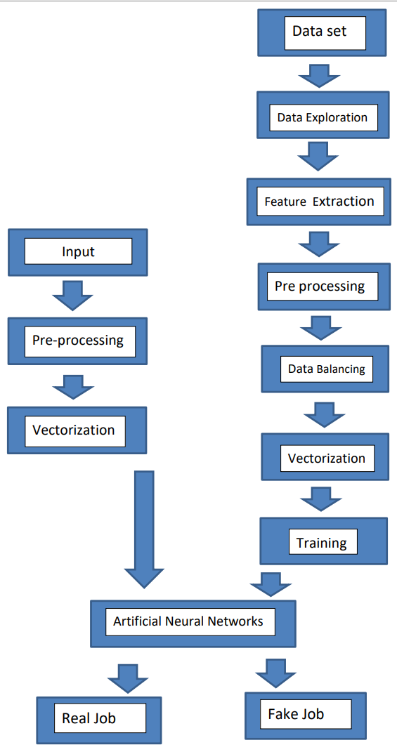
DESIGN :

Slide 6
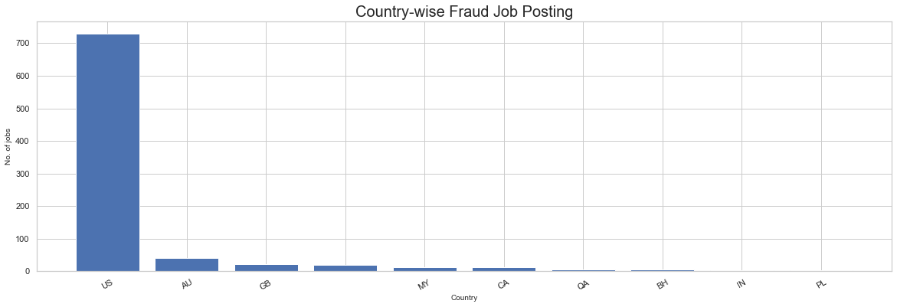
Data Exploration :

Slide 7
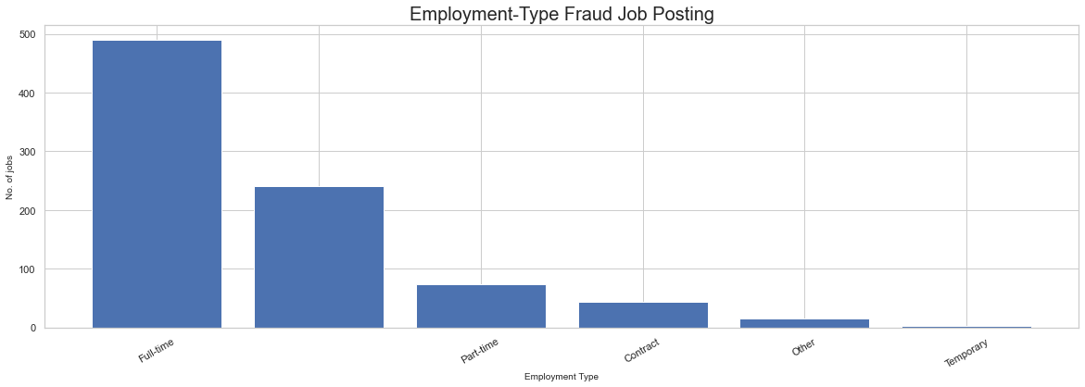

Slide 8
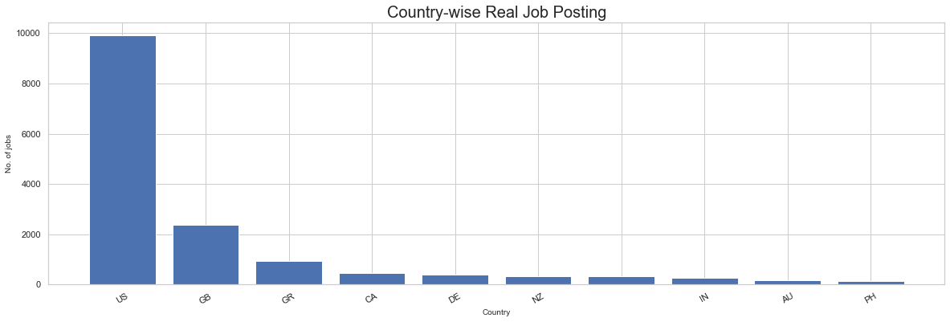

Slide 9
Feature Extraction :
Job_id
Title
Location
Employment_type
Company_profile
Salary_range
fradulent
Required_education
Description
Required_experience
Requirements
Has_company_logo
Has_questions
Department
Telecommunicating

Slide 10
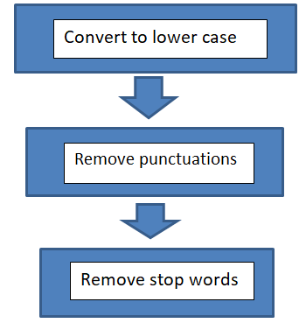
Data Pre Processing :

Slide 11
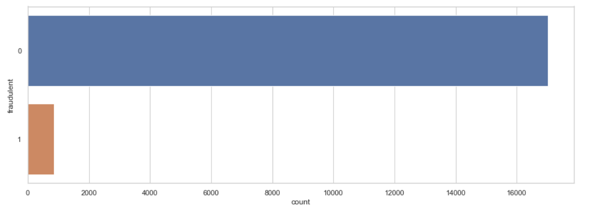
Dataset Before Balancing data :

Slide 12
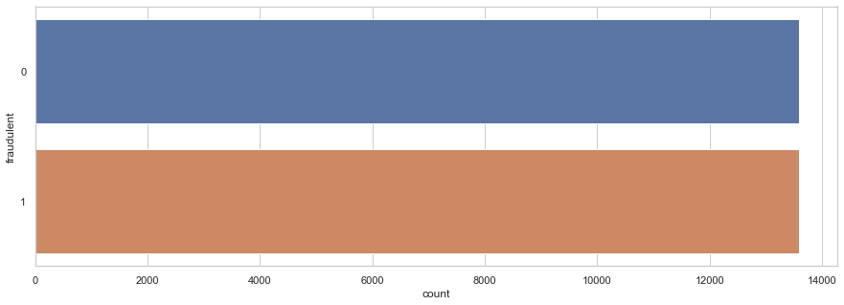
Dataset after Balancing data :

Slide 13
TOOLS AND TECHNOLOGY STACK
ENVIRONMENT | SPECIFICATIONS
HARDWARE | Processor - Intel Core i3
 | Memory(RAM) - 4 GB
 | Storage - 32 GB and above
SOFTWARE | Python 3.8.5, Django framework, Jupyter Notebook
 | OS - Windows 10

Slide 14
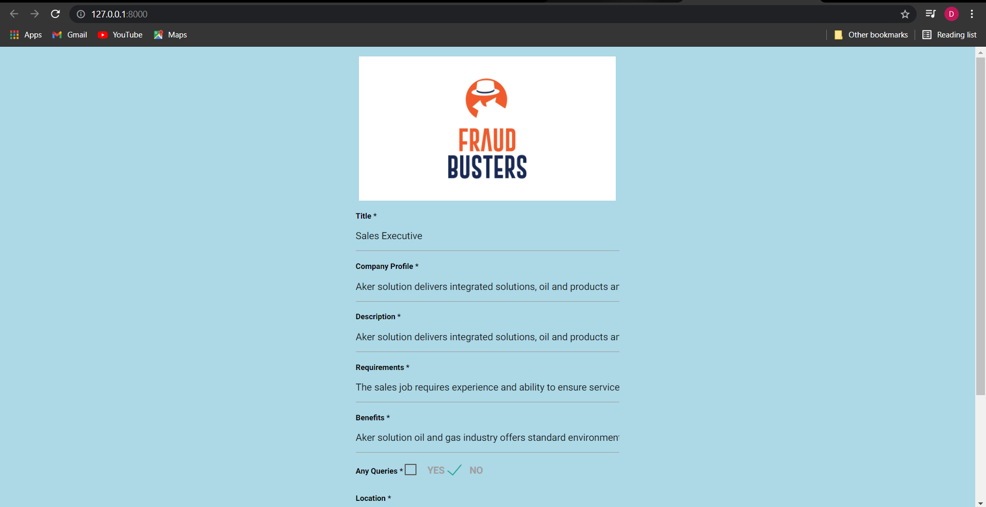
A Look into the project :

Slide 15
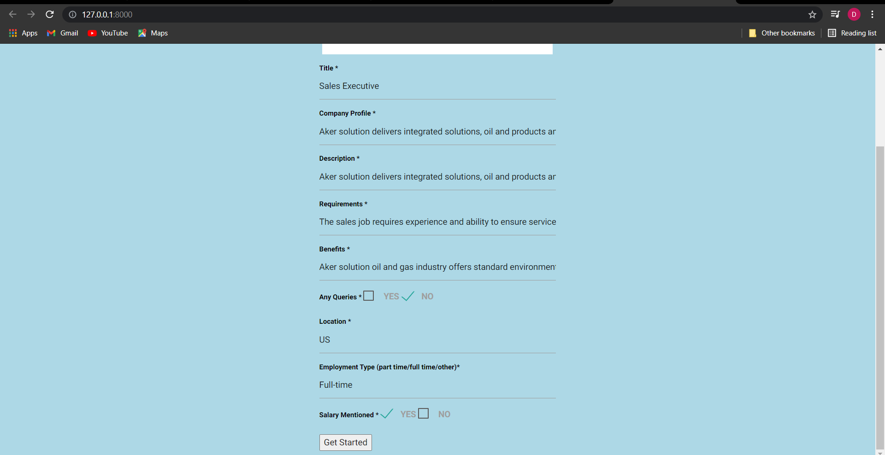

Slide 16

Output if the job posting is Real

Slide 17
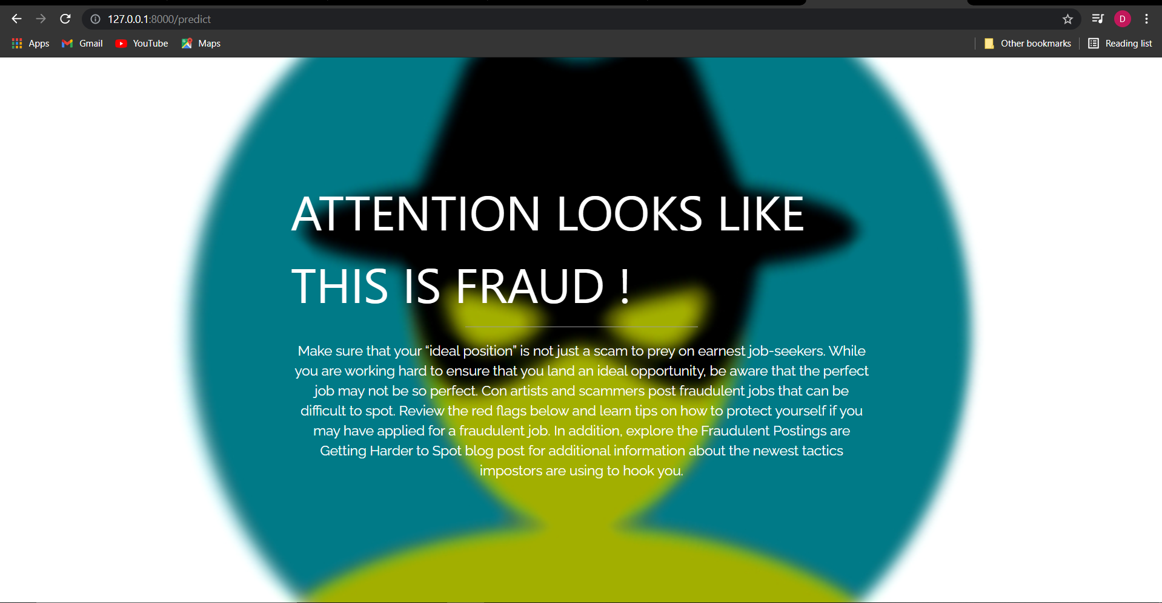
Output if the job Posting is Fake

Slide 18
Datasets and References
Dataset:
Real / Fake job posting prediction - Kaggle
https://www.kaggle.com/shivamb/real-or-fake-fake-jobposting-prediction

Slide 19
References
Habiba, S. U., Islam, M. K., & Tasnim, F. (2021). A Comparative Study on Fake Job Post Prediction Using Different Data mining Techniques. 2021 2nd International Conference on Robotics, Electrical and Signal Processing Techniques (ICREST).
Devsmit Ranparia, Shaily Kumari, Ashish Sahani. (2020), Fake Job Prediction using Sequential Network. 2020 IEEE 15th International Conference on Industrial and Information Systems (ICIIS).
Shawni Dutta, Prof.Samir Kumar Bandyopadhyay, Fake Job Recruitment Detection Using Machine Learning Approach (IJETT).

Slide 20
Website Links
1 https://towardsdatascience.com/fake-job-predictor-a168a315d866
2 https://www.youtube.com/watch?v=dkXB8HH_4-k
3 https://www.youtube.com/watch?v=Qkcce86nqFQ

Slide 21
Demo

Slide 22
Thank You

